Slide 1
Data Management Principles
Pravin Y Pawar
Adapted from
Reliable Machine Learning
By Chen, Murphy, Sculley, Underwood

Slide 2
Data and ML Pipelines
Relation
ML systems are data processing pipelines
with a purpose to extract usable and repeatable insights from data
fundamentally, they consume data, and output a processed representation of that data
Key differences between ML pipelines and conventional log processing or analysis pipelines
have some very different and specific constraints and fail in different ways
success is hard to measure,
many failures are difficult to detect
depend thoroughly and completely on the structure, performance, accuracy, and reliability of their underlying data systems
Overwhelmingly interested in two things:
the data used to construct the models
the processing pipeline that takes the data and transforms it into models

Slide 3
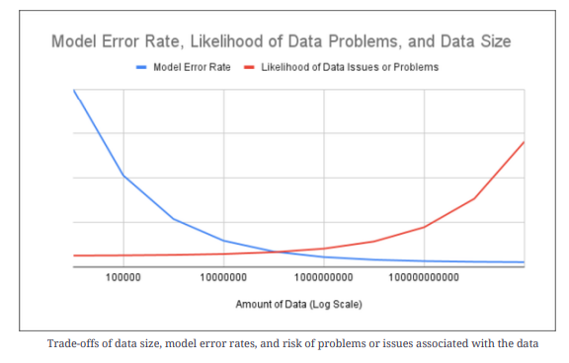
Data as Asset
Unarguably data is an important asset in ML systems
certainly impossible to have an ML system without data
often true that a simple (or even simplistic) ML system with more (and higher-quality) training data can outperform a more sophisticated system with less, or less representative, data
Organizations continue to scramble to collect as much data as possible, hoping to find ways to turn that data into value
many organizations have made this into a profoundly successful business model
Netflix, whose ability to recommend high-quality shows and movies to customers was an early differentiator

Slide 4
Data as Liability
Anything could be an asset, under the right (wrong) circumstances, it can also be a liability
For data, the acquisition, collection, and curation of data can expose areas of unexpected nuance and complexity in the data
can lead to potential harm for us and for our users
The intent is to enumerate enough of the complexity to dissuade any readers from
simply thinking “more data == better” or
thinking “this stuff is easy

Slide 5
Data as Liability(2)
Questions with data collection
Data must be collected in compliance with applicable laws, which might be based on
where organization is located
where the data originates
on organizational policies
Significant restrictions on
what counts as data about people
how to get permission to store the data
how to store and retrieve the permission that was granted
whether we need to provide access to the data to the people who provided it and under what circumstances
Restrictions may come from
laws
industry practices
insurance regulations
corporate governance policies
or any range of other sources
For example, some jurisdictions include prohibition against
collecting personally identifiable information (PII) about an individual without their explicit written consent
along with the requirement to delete that data upon request by the data subject
Not technical question, but policy question!

Slide 6
Data as Liability(3)
Questions with data storage
Data must be secured from external and internal access
Employees should not be able to view or change private user data without restriction and without detailed
logging of that
Pseudonymization
approach to reducing data access and reducing the auditing surface is to anonymize the data
private identifiers are replaced with others in a reversible fashion, and reversing the pseudonymization
requires access to an additional data or system
protects the data from casual inspection by engineers working on the pipeline but permits discovery if we find
that we need to reverse the anonymization
preserves the properties of data that are relevant to ML model
A better approach is permanently removing any direct connection between private data about a
person and the data that we use to train on
substantially reduce the risk of the data and increase the flexibility to handle it
harder than it seems!
Doing this in a way that’s not trivially reversible but still valuable can be difficult

Slide 7
Data as Liability(4)
Questions with data deletion
Might need to delete data
at the request of individual users, local laws, regulations, compliances
in cases where we no longer have permission to store the data
Deleting data and having it actually be deleted is surprisingly hard!
been true since at least the early MS-DOS days
today’s computing environment makes deletion even harder due to multiple copies of the data and metadata management
Important to be certain that people want their data deleted without putting up arbitrary barriers
impose a short delay before really deleting the data
also underlying data structures, indices, and backups may be reconstructed

Slide 8
The Data Sensitivity of ML Pipelines
ML pipelines are unusually sensitive to their input data compared to most other data processing pipelines
All data processing pipelines are subject to the correctness and volume of their input data
ML pipelines are furthermore sensitive to subtle changes in distribution of the data
can easily go from mostly right to significantly wrong simply by omitting a small fraction of the data
For example, consider a real-world system that somehow loses all of the data from a particular country, region, or language
drop all of the data from December 31 of a given year, lose the ability to detect New Year’s Eve shopping trends
treads may be substantially different from the surrounding days in December and January
results into systematically biased results in significant confusion in models’ understanding and predictions
As a result of this sensitivity, the ability to aggregate, process, and monitor data is critical to successfully managing ML data pipelines.

Slide 9
Data Reliability
Because our data processing system needs to work, the data must have several characteristics as it traverses the system
Needs to know basics of making sure that
the data is not lost (durability)
is the same for all copies (consistency)
is tracked carefully as it changes over time (version control)
is read fast enough (performance)
is ready to be read (availability)

Slide 10
Thank You!
In our next session:

